Slide 1

Natural Language Processing
Yue Zhang
Westlake University

Slide 2
Chapter 16
Working With Two Texts

Slide 3
Contents
16.1 Sequence to sequence models
16.1.1 Model 1: Seq2seq using LSTM
16.1.2 Model 2: Adding more source features using target-to-source attention
16.1.3 Model 3: Copying form the source
16.1.4 Subword Embedding
16.1.5 Seq2seq using Attention Network
16.2 Text Matching Models
16.2.1 Matching Two Texts in Parallel
16.2.2 Searching for a match
16.2.3 Memory network

Slide 4
Contents
16.1 Sequence to sequence models
16.1.1 Model 1: Seq2seq using LSTM
16.1.2 Model 2: Adding more source features using target-to-source attention
16.1.3 Model 3: Copying form the source
16.1.4 Subword Embedding
16.1.5 Seq2seq using Attention Network
16.2 Text Matching Models
16.2.1 Matching Two Texts in Parallel
16.2.2 Searching for a match
16.2.3 Memory network

Slide 5
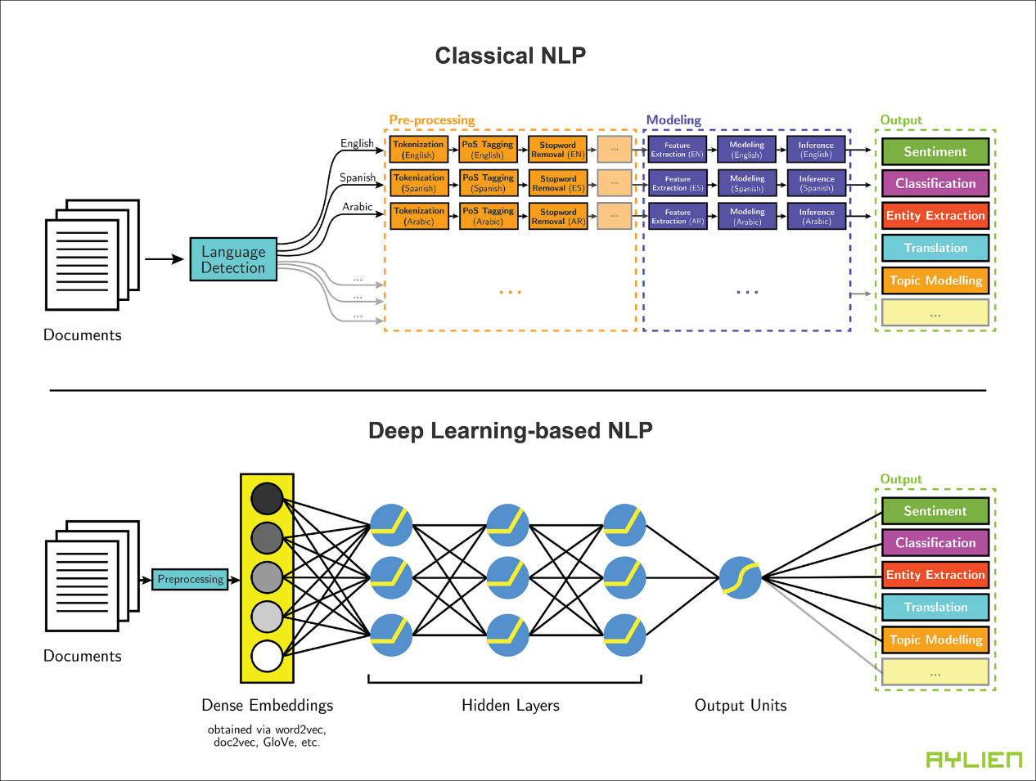
End-to-End Architectures
Using neural models, hand-crafted features can be replaced by Dense Representation.
A pipelined approach with sub-systems can be replaced by a simple end-to-end system.
Classical NLP
Pre-processing
Modeling
Output
Tokenization
Feature extraction
Classification
Language
detection
PoS tagging
Modeling
NER
Stopword removal
Inference
Translation
…
…
…

Slide 6
End-to-End Architectures
Using neural models, hand-crafted features can be replaced by Dense Representation.
A pipelined approach with sub-systems can be replaced by a simple end-to-end system.
Embeddings
Hidden layers
Output
Neural models
Classification
Preprocessing
NER
…
Translation

Slide 7
End-to-End Architectures
Take an example of Machine Translation:
Bilingual
text
Translation
model
Source text
Classic
SMT
Decoder
Target
text
Language
model
Target text
Neural
MT
Encoder
Neural Network e.g. RNN
Encoder
Neural Network e.g. RNN
Source text
Target text

Slide 8
End-to-End Architectures
Sequence-to-sequence is useful for more than just MT
Many NLP tasks can be phrased as sequence-to-sequence:
Machine translation(source text → target text)
Summarization (long text → short text)
Dialogue (previous utterances → next utterance)

Slide 9
Encoder-Decoder Structure
Encoder for learning a neural input representation.
Decoder for constructing the output sequence.
For Machine Translation:
Source
language
-0.2
-0.1
0.2
0.3
-0.3
1.1
Target
language
encoder
decoder
RNNs/SANs
RNNs/SANs

Slide 10
Encoder-Decoder Structure
Encoder for learning a neural input representation.
Decoder for constructing the output sequence.
For Dialogue System:
User
utterance
-0.2
-0.1
0.2
0.3
-0.3
1.1
System
response
encoder
decoder
RNNs/SANs
RNNs/SANs

Slide 11
Contents
16.1 Sequence to sequence models
16.1.1 Model 1: Seq2seq using LSTM
16.1.2 Model 2: Adding more source features using target-to-source attention
16.1.3 Model 3: Copying form the source
16.1.4 Subword Embedding
16.1.5 Seq2seq using Attention Network
16.2 Text Matching Models
16.2.1 Matching Two Texts in Parallel
16.2.2 Searching for a match
16.2.3 Memory network

Slide 12
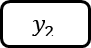
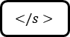

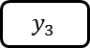
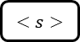

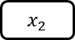


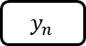
Model 1: Seq2seq using LSTM
Encoding and Decoding with LSTM
Given an input sentence: $X_{1:n}=x_{1},x_{2},…,x_{n}$
$y_{1}$
$y_{2}$
$y_{3}$
$</s>$
LSTM
LSTM
···
LSTM
LSTM
LSTM
···
LSTM
$x_{1}$
$x_{2}$
···
$<s>$
$y_{1}$
$y_{2}$
···
$y_{n}$
Generating an output sentence: $Y_{1:m}=y_{1},y_{2},…,y_{m}$

Slide 13
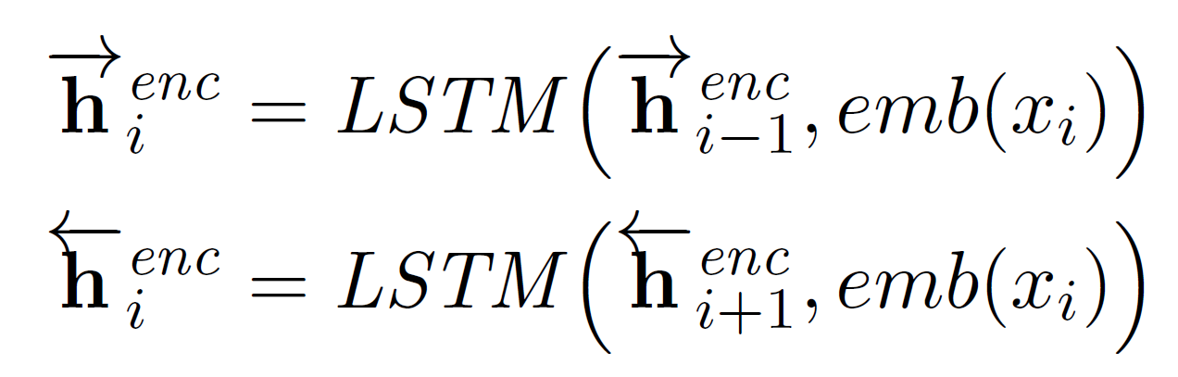
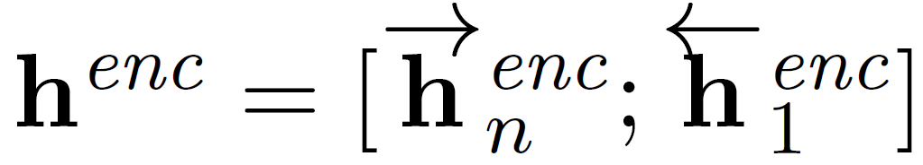
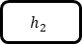

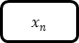

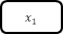

Model 1: Seq2seq using LSTM
Encoder: Bi-directional LSTM
$$h_{1}$$
$$h_{2}$$
$$h_{n}$$
LSTM
LSTM
LSTM
LSTM
LSTM
LSTM
$x_{1}$
$x_{2}$
$x_{n}$
To decoder

Slide 14
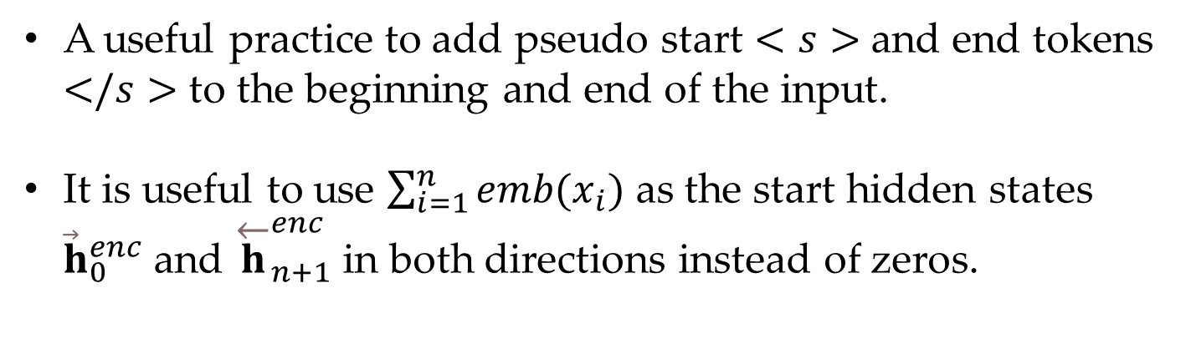
Model 1: Seq2seq using LSTM
Encoder: some tips
A useful practice to add pseudo start $<s>$ and end tokens $</s>$ to the beginning and end of the input.
It is useful to use $\sum_{i=1}^{n}{emb(x_{i})}$ as the start hidden states ${\vec{h}}_{0}^{enc}$ and ${\overset{←}{h}}_{n+1}^{enc}$ in both directions instead of zeros.

Slide 15
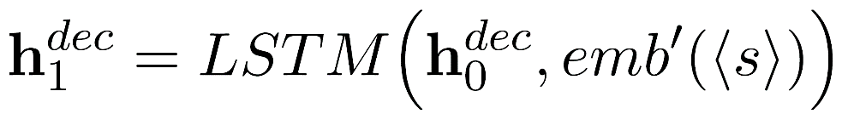
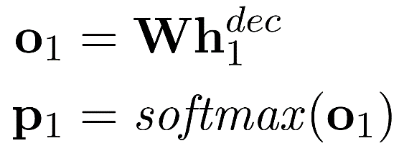

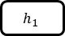
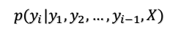
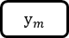
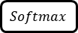
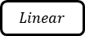
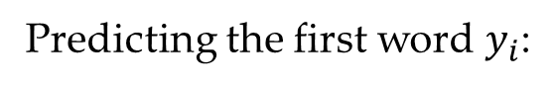
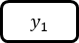
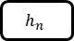
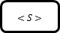
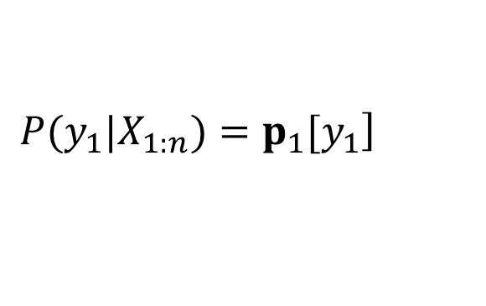

Model 1: Seq2seq using LSTM
Decoder: output of encoder is used as an initial state $h_{0}^{dec}$
$$Softmax$$
$$p(y_{i}|y_{1},y_{2},…,y_{i−1},X)$$
$$Linear$$
Predicting the first word $y_{i}$:
$$h_{1}$$
$$h_{2}$$
$$h_{n}$$
Encoder
LSTM
LSTM
LSTM
$<S>$
$y_{1}$
$y_{m}$
$$\left.P(y_{1}|X_{1:n})=p_{1}[y_{1}\right]$$

Slide 16
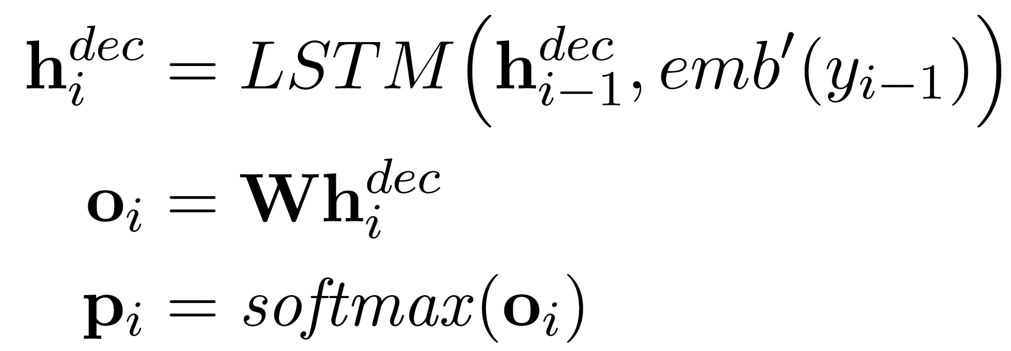
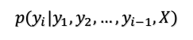

Model 1: Seq2seq using LSTM
Decoder: each subsequent step $i$
$$Softmax$$
$$p(y_{i}|y_{1},y_{2},…,y_{i−1},X)$$
$$Linear$$
$$h_{1}$$
$$h_{2}$$
$$h_{n}$$
Encoder
LSTM
LSTM
LSTM
$<S>$
$y_{1}$
$y_{m}$

Slide 17
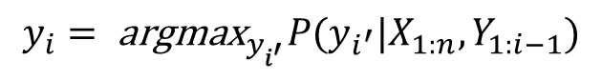

Model 1: Seq2seq using LSTM
Decoder: each subsequent step $i$
$$Softmax$$
$$p(y_{i}|y_{1},y_{2},…,y_{i−1},X)$$
$$Linear$$
$$h_{1}$$
$$h_{2}$$
$$h_{n}$$
Encoder
LSTM
LSTM
LSTM
$<S>$
$y_{1}$
$y_{m}$
A greedy local Greedy search:
$$y_{i}={ \text{argmax}}_{y_{i^{′}}}P(y_{i^{′}}|X_{1:n},Y_{1:i−1})$$

Slide 18
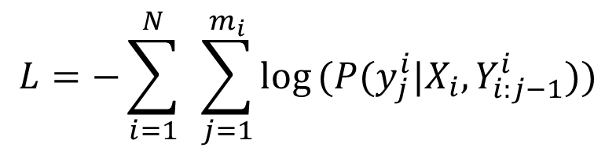
Model 1: Seq2seq using LSTM
Training:
Given an input sentence: $X_{1:n}=x_{1},x_{2},…,x_{n}$
$$L=−\sum_{i=1}^{N}{ }\sum_{j=1}^{m_{i}}{log}(P(y_{j}^{i}|X_{i},Y_{i:j−1}^{i}))$$
Generating an output sentence: $Y_{1:m}=y_{1},y_{2},…,y_{m}$

Slide 19
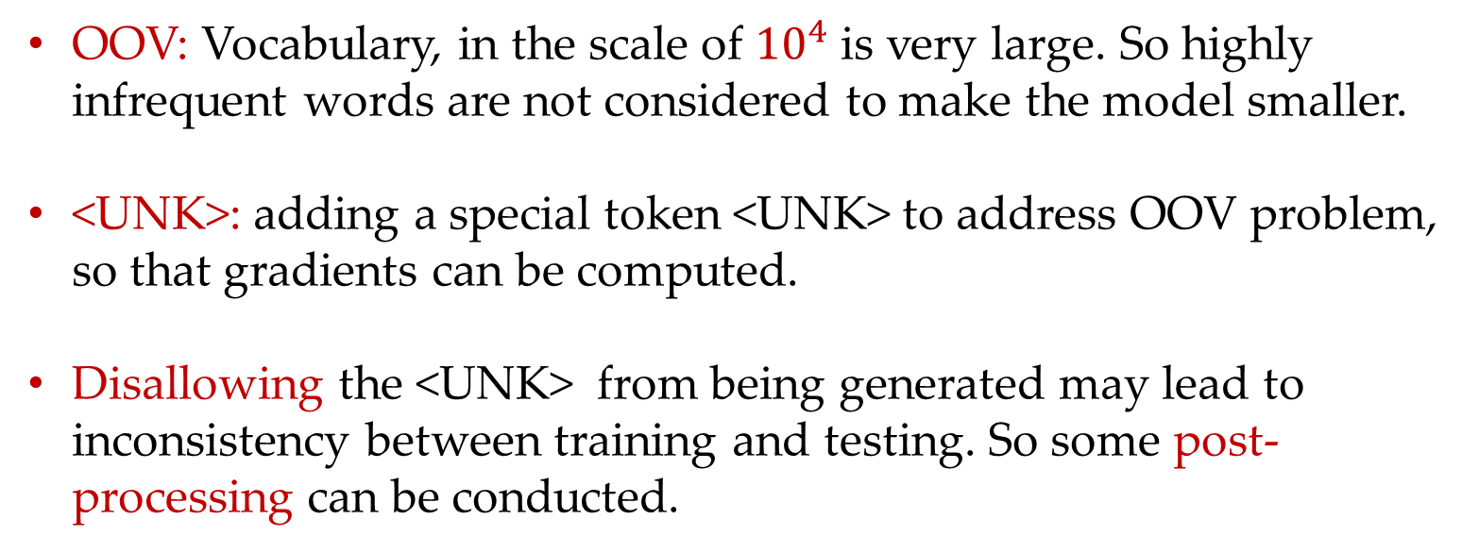
Model 1: Seq2seq using LSTM
Target vocabulary
OOV: Vocabulary, in the scale of ${10}^{4}$ is very large. So highly infrequent words are not considered to make the model smaller.
<UNK>: adding a special token <UNK> to address OOV problem, so that gradients can be computed.
Disallowing the <UNK> from being generated may lead to inconsistency between training and testing. So some post-processing can be conducted.

Slide 20
Contents
16.1 Sequence to sequence models
16.1.1 Model 1: Seq2seq using LSTM
16.1.2 Model 2: Adding more source features using target-to-source attention
16.1.3 Model 3: Copying form the source
16.1.4 Subword Embedding
16.1.5 Seq2seq using Attention Network
16.2 Text Matching Models
16.2.1 Matching Two Texts in Parallel
16.2.2 Searching for a match
16.2.3 Memory network

Slide 21

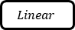

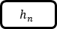
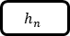

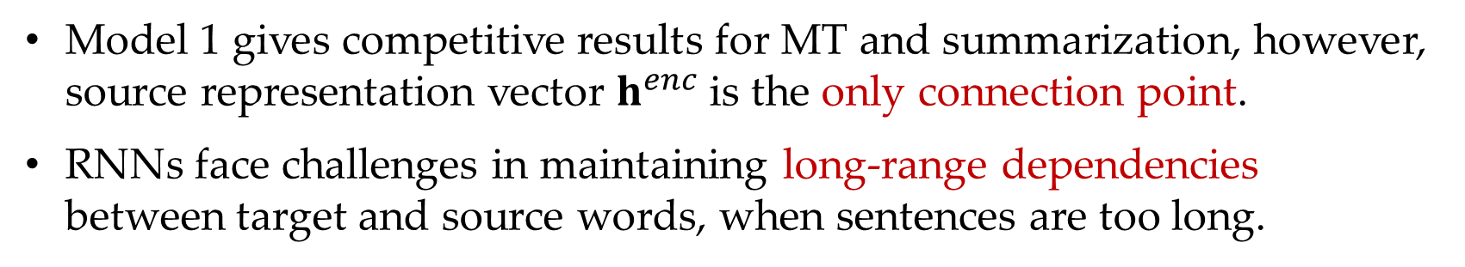

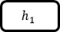

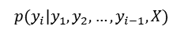
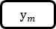
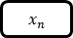

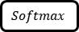
Model 2: LSTM using attention
Lack of model 1
Model 1 gives competitive results for MT and summarization, however, source representation vector $h^{enc}$ is the only connection point.
RNNs face challenges in maintaining long-range dependencies between target and source words, when sentences are too long.
$$Softmax$$
$$p(y_{i}|y_{1},y_{2},…,y_{i−1},X)$$
$$h_{1}$$
$$h_{2}$$
$$h_{n}$$
$$Linear$$
LSTM
LSTM
LSTM
$$h_{1}$$
$$h_{2}$$
$$h_{n}$$
LSTM
LSTM
LSTM
LSTM
LSTM
LSTM
$x_{1}$
$x_{2}$
$x_{n}$
$<S>$
$y_{1}$
$y_{m}$

Slide 22
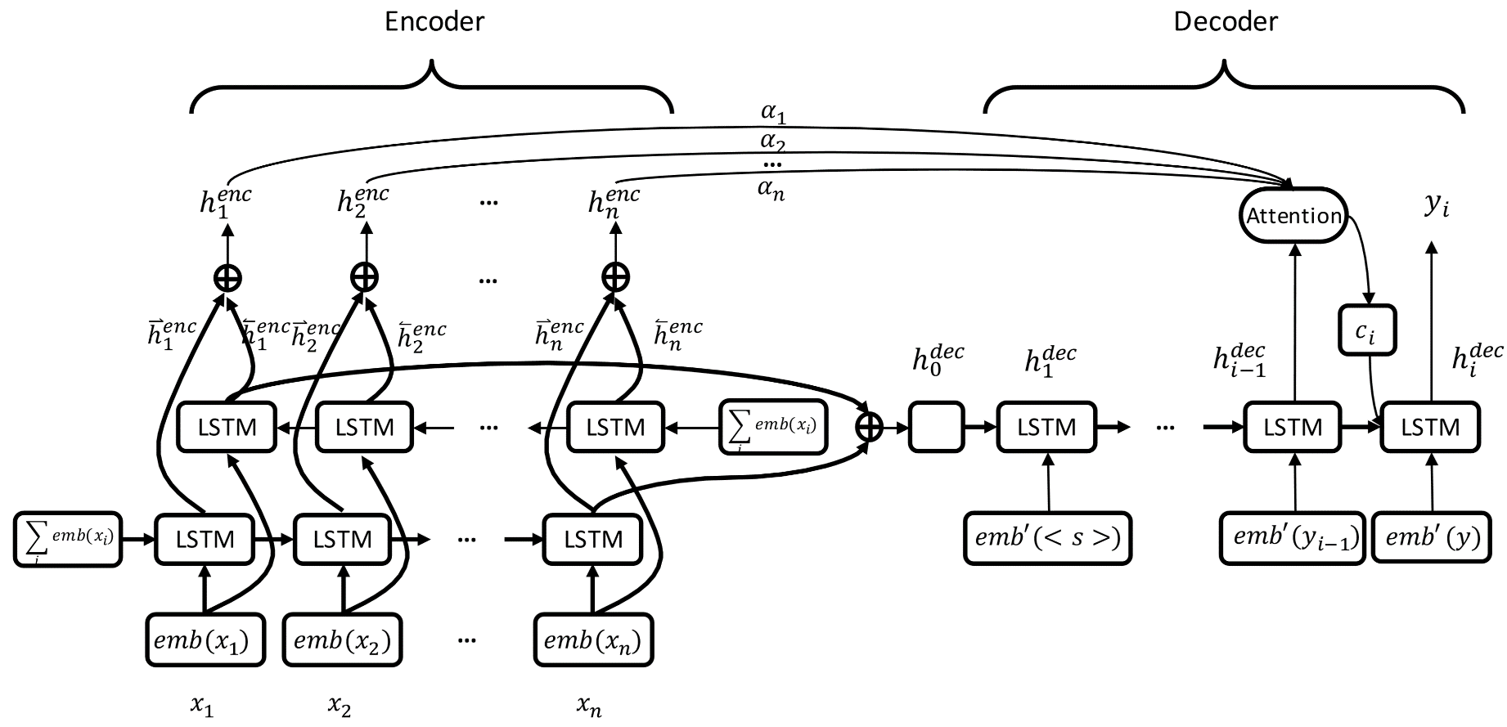
Model 2: LSTM using attention
Intuition beyond model 1
Keep the source at hand in each generating step.
Consider the hidden states for each source word simultaneously as the representation of whole source sentence rather than using only the last hidden states.

Slide 23
Model 2: LSTM using attention
Construct a context vector using attention mechanism

Slide 24

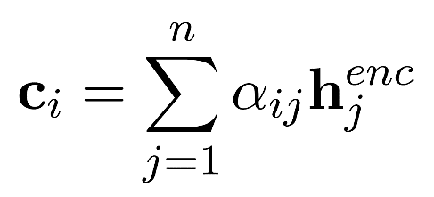
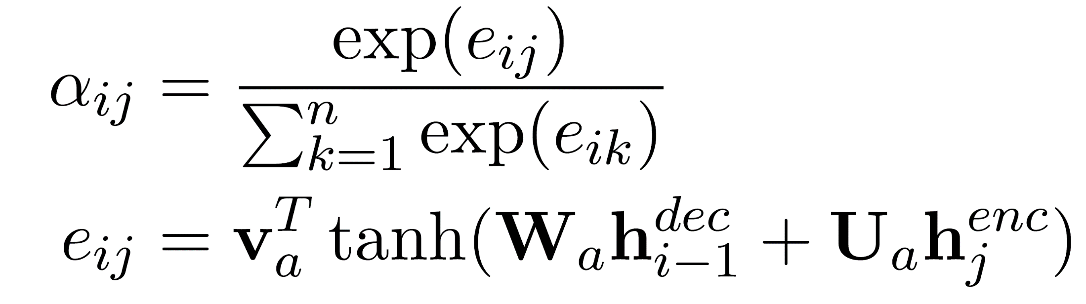
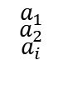
Model 2: LSTM using attention
Construct a context vector using attention mechanism
$$a_{1}$$
$$a_{2}$$
$$a_{i}$$

Slide 25
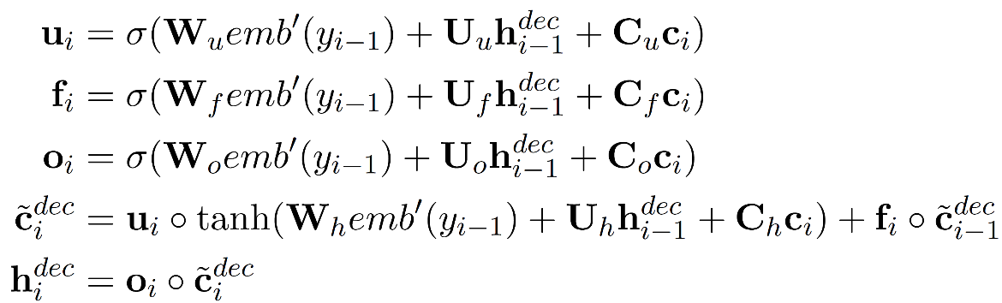
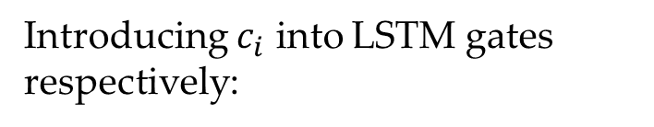
Model 2: LSTM using attention
Construct a context vector using attention mechanism
$$a_{1}$$
$$a_{2}$$
$$a_{i}$$
Introducing $c_{i}$ into LSTM gates respectively:

Slide 26
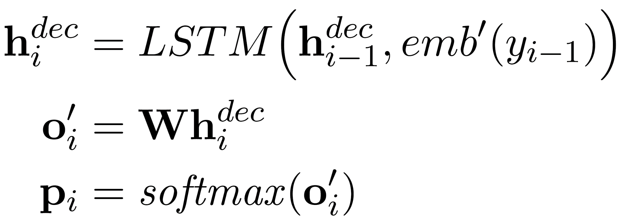
Model 2: LSTM using attention
Generation using attention mechanism as model 1
$$a_{1}$$
$$a_{2}$$
$$a_{i}$$

Slide 27
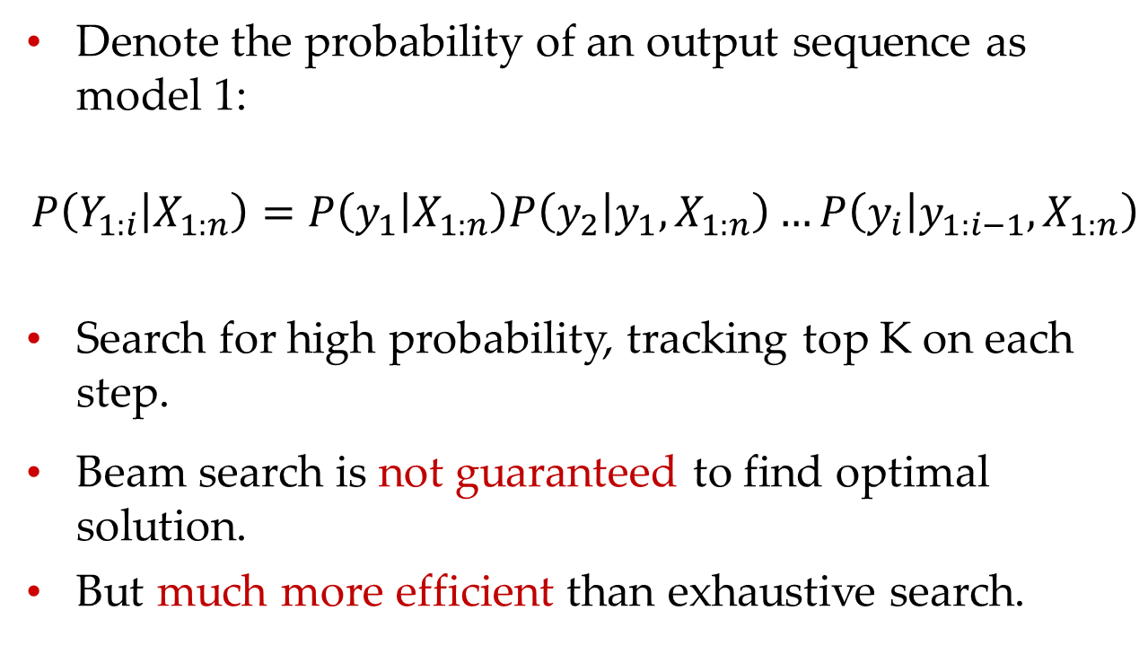
Model 2: LSTM using attention
Beam search:
Denote the probability of an output sequence as model 1:
$$P\left(Y_{1:i} | X_{1:n}\right)=P\left(y_{1} | X_{1:n}\right)P\left(y_{2} | y_{1},X_{1:n}\right)…P\left(y_{i} | y_{1:i−1},X_{1:n}\right)$$
Search for high probability, tracking top K on each step.
Beam search is not guaranteed to find optimal solution.
But much more efficient than exhaustive search.

Slide 28
Model 2: LSTM using attention
Beam search : example (beam size: K= 2)
<S>
Calculate probability
of next word

Slide 29
Model 2: LSTM using attention
Beam search : example (beam size: K= 2)
1.1 = P( he|<START> ) + 0.6
he
.
.
.
<S>
I
0.9 = P( I|<START>)
Take top K words and compute scores

Slide 30
Model 2: LSTM using attention
Beam search : example (beam size: K= 2)
1.5 = P( love|<START> he) + 0.6
0.6
love
he
hit
.
.
.
1.1 = P( hit|<START> he) + 0.6
<S>
1.8 = P( like|<START> I) + 0.9
like
I
get
0.9
1.4 = P( like|<START> I) + 0.9
For each of the K hypotheses, find
top K next words and calculate scores

Slide 31
Model 2: LSTM using attention
Beam search : example (beam size: K= 2)
1.5
0.6
love
he
hit
1.1
<S>
1.8
like
I
get
0.9
1.4
Just keep K words with highest scores

Slide 32
Model 2: LSTM using attention
Beam search : example (beam size: K= 2)
1.9 = P( NLP|<START> he love) + 1.5
1.5
NLP
0.6
love
he
study
hit
.
.
.
1.7 = P( study|<START> he love) + 1.1
1.1
<S>
2.6 = P( to|<START> I like) + 1.8
1.8
to
like
I
play
get
0.9
2.7 = P( play|<START> I like) + 1.8
1.4
For each of the K hypotheses, find
top K next words and calculate scores

Slide 33
Model 2: LSTM using attention
Beam search : example (beam size: K= 2)
1.9
1.5
NLP
0.6
love
he
study
hit
1.7
1.1
<S>
2.6
1.8
to
like
I
play
get
0.9
2.7
1.4
Just keep K words with highest scores

Slide 34
Model 2: LSTM using attention
Beam search : example (beam size: K= 2)
1.9
1.5
NLP
0.6
love
he
study
hit
3.1
1.7
1.1
go
<S>
2.6
learn
1.8
to
like
3.5
I
play
3.4
get
0.9
2.7
with
1.4
on
For each of the K hypotheses, find
top K next words and calculate scores
3.0
4.0

Slide 35
Model 2: LSTM using attention
Beam search : example (beam size: K= 2)
1.9
1.5
NLP
0.6
love
he
study
hit
3.1
1.7
1.1
go
<S>
2.6
learn
1.8
to
like
3.5
I
play
3.4
get
0.9
2.7
with
1.4
on
Just keep K words with highest scores
3.0
4.0

Slide 36
Model 2: LSTM using attention
Beam search : example (beam size: K= 2)
1.9
1.5
NLP
0.6
love
he
study
hit
3.1
4.2
1.7
to
1.1
go
<S>
2.6
learn
NLP
1.8
to
like
3.5
4.4
I
play
3.4
3.8
get
0.9
2.7
with
a
1.4
on
me
For each of the K hypotheses, find
top K next words and calculate scores
3.0
4.0

Slide 37
Model 2: LSTM using attention
Beam search : example (beam size: K= 2)
1.9
1.5
NLP
0.6
love
he
study
hit
3.1
4.2
1.7
to
1.1
go
<S>
2.6
learn
NLP
1.8
to
like
3.5
4.4
I
play
3.4
3.8
get
0.9
2.7
with
a
1.4
on
me
This is the top-scoring hypothesis!
3.0
4.0

Slide 38
Model 2: LSTM using attention
Beam search : example (beam size: K= 2)
1.9
1.5
NLP
0.6
love
he
study
hit
3.1
4.2
1.7
to
1.1
go
<S>
2.6
learn
NLP
1.8
to
like
3.5
4.4
I
play
3.4
3.8
get
0.9
2.7
with
a
1.4
on
me
Backtrack to obtain the full hypothesis
3.0
4.0

Slide 39
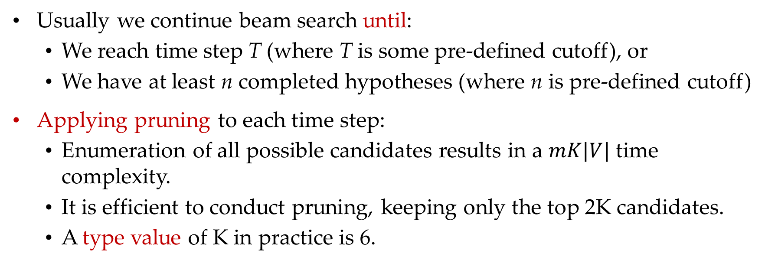
Model 2: LSTM using attention
Beam search: tips
Usually we continue beam search until:
We reach time step T (where T is some pre-defined cutoff), or
We have at least n completed hypotheses (where n is pre-defined cutoff)
Applying pruning to each time step:
Enumeration of all possible candidates results in a $mK|V|$ time complexity.
It is efficient to conduct pruning, keeping only the top 2K candidates.
A type value of K in practice is 6.

Slide 40
Contents
16.1 Sequence to sequence models
16.1.1 Model 1: Seq2seq using LSTM
16.1.2 Model 2: Adding more source features using target-to-source attention
16.1.3 Model 3: Copying form the source
16.1.4 Subword Embedding
16.1.5 Seq2seq using Attention Network
16.2 Text Matching Models
16.2.1 Matching Two Texts in Parallel
16.2.2 Searching for a match
16.2.3 Memory network

Slide 41
Model 3: Copying from the source
Copying is useful
For machine translation, some technological terminologies can be better left.
I like to learn NLP. → 我喜欢学习NLP。
For dialogue, part of user utterance can be directly included in a system response.
Input: Hello , my name is XXX.
Response: Nice to meet you, XXX.
copy

Slide 42
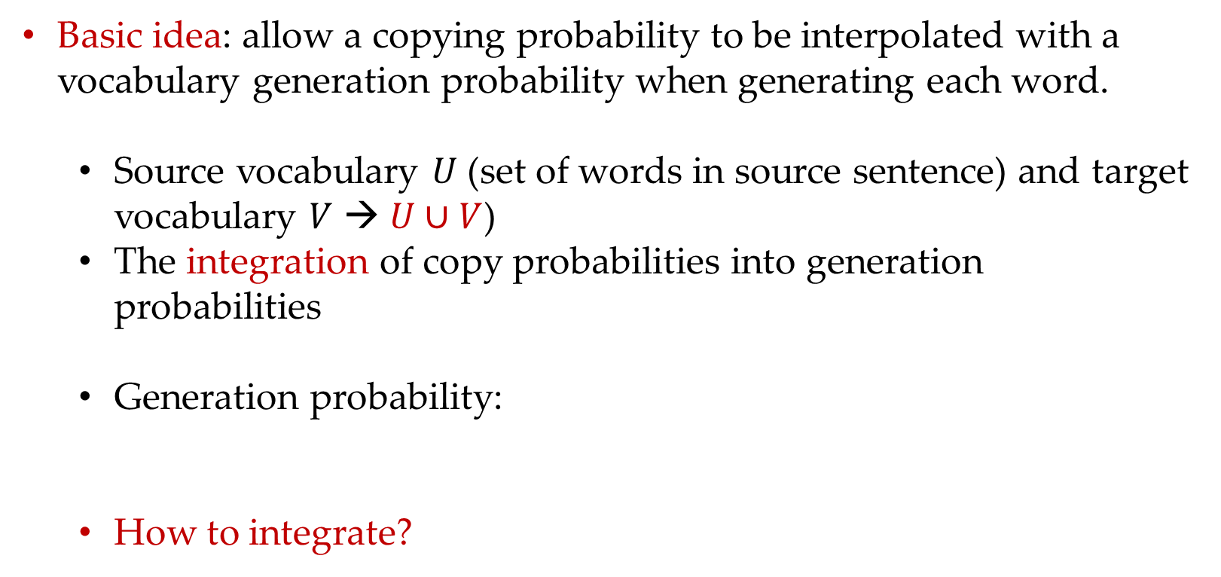
Model 3: Copying from the source
Copying: intuition
Basic idea: allow a copying probability to be interpolated with a vocabulary generation probability when generating each word.
Source vocabulary $U$ (set of words in source sentence) and target vocabulary $V$ → $U∪V$)
The integration of copy probabilities into generation probabilities
Generation probability:
How to integrate?

Slide 43
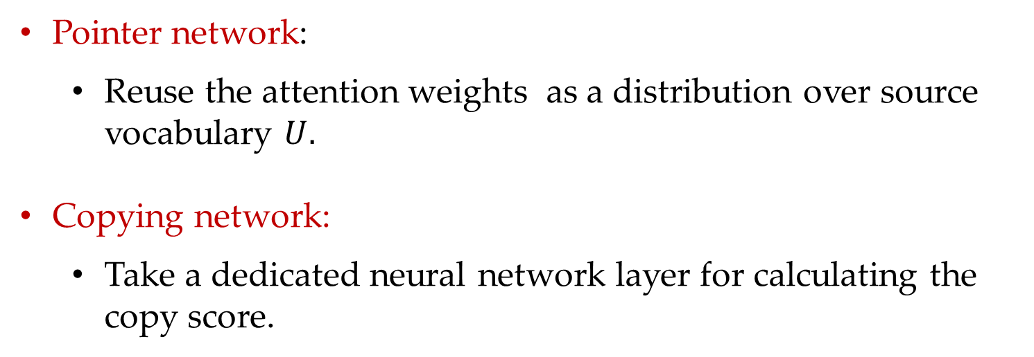
Model 3: Copying from the source
Copying: How to integrate copy probabilities ?
Pointer network:
Reuse the attention weights as a distribution over source vocabulary $U.$
Copying network:
Take a dedicated neural network layer for calculating the copy score.

Slide 44



Model 3: Copying from the source
Pointer network
Take attention score $α_{ij}$ as the distribution of a pointer to a source word:
The pointers to the same word in the source vocabulary $U$ are then aggregated:
Finally, for the generation of $y_{i}$, the generation probability and the copy probability are linearly interpolated:
$$\left.score_{c}(y_{i}=x_{k})=α_{ik},k∈[1,…,n\right]$$
$$score_{c}(y_{i}=u_{j})=\sum_{k:x_{k}= u_{j}}{α_{ik}},u_{j}∈U,j∈[1,…,|U|]$$
$$score(y_{i})=λscore_{g}(y_{i})+(1−λ)score_{c}(y_{i}),$$

Slide 45



Model 3: Copying from the source
Copying network
A copying network calculates $score_{c}$ directly, by taking the current decoding state $h_{i−1}^{dec}$ and the encoder hidden state of a source word $h_{j}^{enc}$ as input:
The probability of generating a target word $y_{i}$ is calculated by the sum of a generate probability and a copy probability:
$$score_{c}(y_{i}=u_{k})=\sum_{j:x_{j}=u_{k}}{tanh}(h_{j}^{enc}W^{c})h_{i−1}^{dec}$$
$$\left.P(y_{i}|X_{1:n},Y_{1:i−1})=P_{g}(y_{i}|X_{1:n},Y_{1:i−1})+P_{c}(y_{i}|X_{1:n},Y_{1:i−1}\right)$$

Slide 46


Model 3: Copying from the source
Copying network
$P_{g}$ and $P_{c}$ represents normalized versions of $score_{g}$ and $score_{c}$, which are a part of a distribution $P$ of the generation and copy:
where

Slide 47
Contents
16.1 Sequence to sequence models
16.1.1 Model 1: Seq2seq using LSTM
16.1.2 Model 2: Adding more source features using target-to-source attention
16.1.3 Model 3: Copying form the source
16.1.4 Subword Embedding
16.1.5 Seq2seq using Attention Network
16.2 Text Matching Models
16.2.1 Matching Two Texts in Parallel
16.2.2 Searching for a match
16.2.3 Memory network

Slide 48
Subword Embedding
Dealing with OOV words
The prefix and the suffix can give us hints about the meaning of a word. Inspired of this, we can make use of subwords to enrich vocabulary instead of a <UNK> tokens in model 1, 2 and 3.
First consideration is morphological segmentation, however, it can be ambiguous and not able to cover all words.
Byte-pair encoding (BPE) is a useful algorithm:
Most frequent byte pair → a new byte.

Slide 49

Subword Embedding
Original BPE
Suppose to compress the following text using BPE:
$$aabaadaab$$
The byte-pair $aa$ is the most frequent pair, which can be replaced by an unused code $Z$:
$ZbZdZb$
Then repeat the process with replace $Zb$ by $Y$:
$YZdY$
$YZdY$ is the final representation, since there are no pairs that occur more than once.

Slide 50
Subword Embedding
Expanding the vocabulary using BPE
Start with a vocabulary of characters
Most frequent n-gram pairs → a new n-gram
Corpus
Vocabulary
b, e, d, t, r, a, s, w
2 b e d
2 b e t t e r
3 e a s t
4 w e s t
Start with all characters in vocabulary

Slide 51
Subword Embedding
Expanding the vocabulary using BPE
Start with a vocabulary of characters
Most frequent n-gram pairs → a new n-gram
Corpus
Vocabulary
b, e, d, t, r, a, s, w, st
2 b e d
2 b e t t e r
3 e a st
4 w e st
Add a pair (s, t) with frequency 7

Slide 52
Subword Embedding
Expanding the vocabulary using BPE
Start with a vocabulary of characters
Most frequent n-gram pairs → a new n-gram
Corpus
Vocabulary
b, e, d, t, r, a, s, w, st, be
2 be d
2 be t t e r
3 e a st
4 w e st
Add a pair (b, e) with frequency 4

Slide 53
Subword Embedding
Expanding the vocabulary using BPE
Start with a vocabulary of characters
Most frequent n-gram pairs → a new n-gram
Corpus
Vocabulary
b, e, d, t, r, a, s, w, st, be
2 be d
2 be t t e r
3 e a st
4 w e st
Final vocablary

Slide 54
Subword Embedding
Expanding the vocabulary using BPE
Start with a vocabulary of characters
Most frequent n-gram pairs → a new n-gram
Corpus
Vocabulary
b, e, d, t, r, a, s, w, st, be
2 be d
2 be t t e r
3 e a st
4 w e st
A new OOV word: best
→ be@@ + st

Slide 55
Subword Embedding
Byte Pair Encoding: tips
Have a target vocabulary size and stop when you reach it.
Segmentation is only within words identified by some prior tokenizer.
Automatically decide vocabulary for system.

Slide 56
Contents
16.1 Sequence to sequence models
16.1.1 Model 1: Seq2seq using LSTM
16.1.2 Model 2: Adding more source features using target-to-source attention
16.1.3 Model 3: Copying form the source
16.1.4 Subword Embedding
16.1.5 Seq2seq using Attention Network
16.2 Text Matching Models
16.2.1 Matching Two Texts in Parallel
16.2.2 Searching for a match
16.2.3 Memory network

Slide 57

Seq2seq using Attention Network
Transformer
An extension to SAN in chapter 13.
It has been shown a competitive alternative to RNNs

Slide 58












Seq2seq using Attention Network
Encoder: Self-attention
Self-attention layer
Input of a self-attention layer:
$$h_{1 }{ h}_{2 }{ h}_{3}$$
FFN
FFN
FFN
Output of a self-attention layer:
+
x
x
$$α_{21}$$
$$α_{23}$$
$$v_{1 }{ v}_{2 }{ v}_{3}$$
$x_{1}$
$x_{2}$
$x_{n}$
Q = K = V
I love NLP

Slide 59

Seq2seq using Attention Network
Encoder: Multi-head self-attention
Concat
Scaled Dot-product attention
Scaled Dot-product attention
Scaled Dot-product attention
K Q V
K Q V
K Q V

Slide 60


Seq2seq using Attention Network
Encoder: Layer normalization

Slide 61

Seq2seq using Attention Network
Encoder: Feed-forward sub-layer
$$\begin{matrix}\left.H^{ff^{′}}=ReLU(W^{ff^{′}}H^{lm}+b^{ff^{′}}\right) \\ H^{ff}=W^{ff}H^{ff^{′}}+b^{ff}\end{matrix}$$

Slide 62

Seq2seq using Attention Network
Encoder: output
$$\left.H^{out}=LayerNorm(H^{ff}+H^{lm}\right)$$

Slide 63

Seq2seq using Attention Network
Encoder: input encoding and position embedding
$$\begin{matrix}x_{i}=emb(x_{i})+V_{i}^{p} \\ \left.V_{i}^{p}[2j]=sin(i/{{10000}^{2j/{d_{h}}}}\right) \\ \left.V_{i}^{p}[2j+1]=cos(i/{{10000}^{2j/{d_{h}}}}\right)\end{matrix}$$

Slide 64






Seq2seq using Attention Network
Decoder: similar to encoder
Obtain the next target word
MLP layer
Target to source attention
Target self-attention
Embedding & positional encoding
$$\begin{matrix}o_{i}=W^{dec}h_{i−1}^{dec} \\ \left.p_{i}=softmax(o_{i}\right)\end{matrix}$$
$$\begin{matrix}\left.H^{dff^{′}}=ReLU(W^{dff^{′}}H^{clm}+b^{dff^{′}}\right) \\ H^{dff}=W^{dff}H^{dff^{′}}+b^{dff^{′}} \\ \left.H^{dec}=LayerNorm(H^{dff}+H^{clm}\right)\end{matrix}$$
$$\begin{matrix}\left.H^{c}=MultiHead(H^{dlm},H^{enc},H^{enc}\right) \\ \left.H^{clm}=LayerNorm(H^{c}+H^{dlm}\right)\end{matrix}$$
encoder
$$\begin{matrix}\left.H^{dmh}=MultiHead(Y_{1:i−1},Y_{1:i−1},Y_{1:i−1}\right) \\ \left.H^{dlm}=LayerNorm(Y_{1:i−1},H^{dmh}\right)\end{matrix}$$
$$\left.Y_{1:i−1}=[emb^{′}(y_{1}),emb^{′}(y_{2}),…,emb^{′}(y_{i−1})\right]$$

Slide 65





Seq2seq using Attention Network
Training:
Given a set of input-output sentence pairs:
Object function:
$$L=−\sum_{i=1}^{N}{ }\sum_{j=1}^{m_{i}}{log}(p_{j}[y_{j}^{i}])=\sum_{i=1}^{N}{ }\sum_{j=1}^{m_{i}}{log}(P(y_{j}^{i}|X_{i},Y_{i:j−1}^{i})$$

Slide 66




Seq2seq using Attention Network
Why self attention:
Layer Type Complexity per Layer Sequential Maximum Path Length
Operations
Self-attention
Recurrent
Convolutional
$$O\left(n^{2}∙d\right)$$
$$O\left({n∙d}^{2}\right)$$
$$O\left({k∙n∙d}^{2}\right)$$
$$O\left(1\right)$$
$$O\left(n\right)$$
$$O\left(1\right)$$
$$O\left(1\right)$$
$$O\left(n\right)$$
$$O\left(\log_{k}(n)\right)$$
$n$= sequence length $d$ = depth $k$ = kernel size

Slide 67
Contents
16.1 Sequence to sequence models
16.1.1 Model 1: Seq2seq using LSTM
16.1.2 Model 2: Adding more source features using target-to-source attention
16.1.3 Model 3: Copying form the source
16.1.4 Subword Embedding
16.1.5 Seq2seq using Attention Network
16.2 Text Matching Models
16.2.1 Matching Two Texts in Parallel
16.2.2 Searching for a match
16.2.3 Memory network

Slide 68

Text Matching Models
Text matching: whether two pieces of text semantically match each other.
Paraphrase detection, text entailment detection…
Searching for a match: find a section in a given piece of text that matches the meaning of another piece of text.
Machine reading comprehension…

Slide 69
Contents
16.1 Sequence to sequence models
16.1.1 Model 1: Seq2seq using LSTM
16.1.2 Model 2: Adding more source features using target-to-source attention
16.1.3 Model 3: Copying form the source
16.1.4 Subword Embedding
16.1.5 Seq2seq using Attention Network
16.2 Text Matching Models
16.2.1 Matching Two Texts in Parallel
16.2.2 Searching for a match
16.2.3 Memory network

Slide 70
Text Matching
Text matching:
How many people live in Melbourne
Matching
Probability
What’s the population of Melbourne

Slide 71

Text Matching
Siamese network:
Apply identical encoders to represent both sentences.
Parameters are shared between both encoders.
How many people live in Melbourne
What’s the population of Melbourne

Slide 72



Text Matching
Siamese network:
$$\begin{matrix}W_{1:n_{1}}^{1}=w_{1}^{1},w_{2}^{1},…,w_{n_{1}}^{1} \\ W_{1:n_{2}}^{2}=w_{1}^{2},w_{2}^{2},…,w_{n_{2}}^{2}\end{matrix}$$
$$\begin{matrix}\left.emb(W^{1})=[emb(w_{1}^{1});emb(w_{2}^{1});…;emb(w_{n_{1}}^{1})\right] \\ \left.emb(W^{2})=[emb(w_{1}^{2});emb(w_{2}^{2});…;emb(w_{n_{2}}^{2})\right]\end{matrix}$$

Slide 73

Text Matching
Siamese network:
$$\begin{matrix}\left.H^{1}=BiLSTM(emb(W^{1})\right) \\ \left.H^{2}=BiLSTM(emb(W^{2})\right)\end{matrix}$$
$$\begin{matrix}W_{1:n_{1}}^{1}=w_{1}^{1},w_{2}^{1},…,w_{n_{1}}^{1} \\ W_{1:n_{2}}^{2}=w_{1}^{2},w_{2}^{2},…,w_{n_{2}}^{2}\end{matrix}$$
$$\begin{matrix}\left.emb(W^{1})=[emb(w_{1}^{1});emb(w_{2}^{1});…;emb(w_{n_{1}}^{1})\right] \\ \left.emb(W^{2})=[emb(w_{1}^{2});emb(w_{2}^{2});…;emb(w_{n_{2}}^{2})\right]\end{matrix}$$

Slide 74



Text Matching
Siamese network:
$$\begin{matrix}W_{1:n_{1}}^{1}=w_{1}^{1},w_{2}^{1},…,w_{n_{1}}^{1} \\ W_{1:n_{2}}^{2}=w_{1}^{2},w_{2}^{2},…,w_{n_{2}}^{2}\end{matrix}$$
$$\begin{matrix}\left.emb(W^{1})=[emb(w_{1}^{1});emb(w_{2}^{1});…;emb(w_{n_{1}}^{1})\right] \\ \left.emb(W^{2})=[emb(w_{1}^{2});emb(w_{2}^{2});…;emb(w_{n_{2}}^{2})\right]\end{matrix}$$

Slide 75



Text Matching
Siamese network:
$$\begin{matrix} \\ \left.P(match(W^{1},W^{2}))=σ(o\right)\end{matrix}$$
$$\left.o=MLP(h^{1}⊕h^{2}\right)$$
$$\begin{matrix}W_{1:n_{1}}^{1}=w_{1}^{1},w_{2}^{1},…,w_{n_{1}}^{1} \\ W_{1:n_{2}}^{2}=w_{1}^{2},w_{2}^{2},…,w_{n_{2}}^{2}\end{matrix}$$
$$\begin{matrix}\left.emb(W^{1})=[emb(w_{1}^{1});emb(w_{2}^{1});…;emb(w_{n_{1}}^{1})\right] \\ \left.emb(W^{2})=[emb(w_{1}^{2});emb(w_{2}^{2});…;emb(w_{n_{2}}^{2})\right]\end{matrix}$$

Slide 76



Text Matching
Training:
Given a set of labeled training data
The training objective function can be to minimize the negative log-likelihood loss function
$$L=−\sum_{i=1}^{N}{(}y_{i}logP(match(W_{i}^{1},W_{i}^{2}))+(1−y_{i})log(1−P(match(W_{i}^{1},W_{i}^{2}))))$$

Slide 77

Text Matching
Attention matching network:
Compared to Siamese network:

Slide 78

Text Matching
Attention matching network:
$$\begin{matrix}\left.emb(W^{1})=[emb(w_{1}^{1});emb(w_{2}^{1});…;emb(w_{n_{1}}^{1})\right] \\ \left.emb(W^{2})=[emb(w_{1}^{2});emb(w_{2}^{2});…;emb(w_{n_{2}}^{2})\right]\end{matrix}$$
Same to the Siamese network

Slide 79


Text Matching
Attention matching network:
$$\begin{matrix}\left.H^{1}=BiLSTM(emb(W^{1})\right) \\ \left.H^{2}=BiLSTM(emb(W^{2})\right)\end{matrix}$$
$$\begin{matrix}\left.emb(W^{1})=[emb(w_{1}^{1});emb(w_{2}^{1});…;emb(w_{n_{1}}^{1})\right] \\ \left.emb(W^{2})=[emb(w_{1}^{2});emb(w_{2}^{2});…;emb(w_{n_{2}}^{2})\right]\end{matrix}$$

Slide 80

Text Matching
Attention matching network:
$$\begin{matrix}\left.s_{ij}=V^{T}tanh(W^{1}h_{i}^{1}+W^{2}h_{j}^{2}+b\right) \\ α_{ij}=\frac{\left.exp(s_{ij}\right)}{\left.\sum_{k=1}^{n_{2}}{exp}(s_{ik}\right)} \\ {\hat{h}}_{i}^{1}=\sum_{j=1}^{n_{2}}{α_{ij}}\end{matrix}$$

Slide 81

Text Matching
Attention matching network:
Additive attention
Denoted:
$$\begin{matrix}\left.{\hat{H}}^{1}=sent_att(H^{1},H^{2}\right) \\ \left.{\hat{H}}^{2}=sent_att(H^{2},H^{1}\right)\end{matrix}$$

Slide 82


Text Matching
Attention matching network:
Concatenate the original vectors and the matching vectors:
$$\begin{matrix}\left.U=avg(Q^{1})⊕max(Q^{1})⊕avg(Q^{2})⊕max(Q^{2}\right) \\ \left.Q^{1}=[h_{1}^{1}⊕{\hat{h}}_{1}^{1};h_{2}^{1}⊕{\hat{h}}_{2}^{1};…;h_{n_{1}}^{1}⊕{\hat{h}}_{n_{1}}^{1}\right] \\ \left.Q^{2}=[h_{1}^{2}⊕{\hat{h}}_{1}^{2};h_{2}^{2}⊕{\hat{h}}_{2}^{2};…;h_{n_{2}}^{2}⊕{\hat{h}}_{n_{2}}^{2}\right]\end{matrix}$$
$ave$: Bitwise average pooling
$max$: Max pooling
$⊕$: Cancatenate

Slide 83


Text Matching
Attention matching network:
Final multilayer perceptron for matching probability:
$$\left.P(match(W^{1},W^{2}))=σ(MLP(U)\right)$$
$$\begin{matrix}\left.U=avg(Q^{1})⊕max(Q^{1})⊕avg(Q^{2})⊕max(Q^{2}\right) \\ \left.Q^{1}=[h_{1}^{1}⊕{\hat{h}}_{1}^{1};h_{2}^{1}⊕{\hat{h}}_{2}^{1};…;h_{n_{1}}^{1}⊕{\hat{h}}_{n_{1}}^{1}\right] \\ \left.Q^{2}=[h_{1}^{2}⊕{\hat{h}}_{1}^{2};h_{2}^{2}⊕{\hat{h}}_{2}^{2};…;h_{n_{2}}^{2}⊕{\hat{h}}_{n_{2}}^{2}\right]\end{matrix}$$
$ave$: Bitwise average pooling
$max$: Max pooling
$⊕$: Cancatenate

Slide 84



Text Matching
Bidirectional attention matching network:
Similarly, Bi-direction attention (co-attention) can be used to extract the mutual information between $H^{1}$ and $H^{2}$.
Attention weight matrix:
The bi-directional attention output $U$
$$\begin{matrix}\left.{\tilde{H}}^{1}=Dup(H^{1},n_{2}\right) \\ \left.{\tilde{H}}^{2}=Dup(H^{2},n_{1}\right) \\ \left.S=avg_{1}(V({\tilde{H}}^{1}⊕(^{ }{\tilde{H}}^{2})T_{2,3}⊕({\tilde{H}}^{1}⊗(^{ }{\tilde{H}}^{2})T_{2,3}))\right)\end{matrix}$$
$$\begin{matrix}\left.α_{1}=softmax_{2}(S\right) \\ \left.α_{2}=softmax_{2}(S^{T}\right)\end{matrix}$$

Slide 85
Contents
16.1 Sequence to sequence models
16.1.1 Model 1: Seq2seq using LSTM
16.1.2 Model 2: Adding more source features using target-to-source attention
16.1.3 Model 3: Copying form the source
16.1.4 Subword Embedding
16.1.5 Seq2seq using Attention Network
16.2 Text Matching Models
16.2.1 Matching Two Texts in Parallel
16.2.2 Searching for a match
16.2.3 Memory network

Slide 86

Searching for a Match
Network structure searching for a match:

Slide 87



Searching for a Match
Network structure searching for a match:
Given a context sequence $W^{1}$
and a query $W^{2}$, the task is to find an answer span
that matches $W^{2}.$

Slide 88

Searching for a Match
Network structure searching for a match:
Encoding with Bi-LSTM
$$\begin{matrix}\left.H^{1}=BiLSTM(emb(W^{1})\right) \\ \left.H^{2}=BiLSTM(emb(W^{2})\right)\end{matrix}$$

Slide 89

Searching for a Match
Network structure searching for a match:
Additive attention for matching:
$$\begin{matrix}\left.s_{ij}=V^{T}tanh(W^{1}h_{i}^{1}+W^{2}h_{j}^{2}+b\right) \\ α_{ij}=\frac{\left.exp(s_{ij}\right)}{\left.\sum_{k=1}^{n_{2}}{exp}(s_{ik}\right)} \\ {\hat{h}}_{i}^{1}=\sum_{j=1}^{n_{2}}{α_{ij}}h_{j}^{2}\end{matrix}$$

Slide 90

Searching for a Match
Network structure searching for a match:
Final representation:
$$\left.U^{1}=[h_{1}^{1}⊕{\hat{h}}_{1}^{1};h_{2}^{1}⊕{\hat{h}}_{2}^{1};…;h_{n_{1}}^{1}⊕{\hat{h}}_{n_{1}}^{1}\right]$$

Slide 91

Searching for a Match
Network structure searching for a match:
Start Predicting:
$$\begin{matrix}\left.M^{b}=BiLSTM(U^{1}\right) \\ \left.Q^{b}=[u_{1}^{1}⊕m_{1}^{b};u_{2}^{1}⊕m_{2}^{b};…;u_{n_{1}}^{1}⊕m_{n_{1}}^{b}\right] \\ \left.s^{b}[i]=(^{v^{b})T}Q_{i}^{b},i∈[1,…,n_{1}\right] \\ \left.p^{b}=softmax(s^{b}\right)\end{matrix}$$

Slide 92

Searching for a Match
Network structure searching for a match:
End Predicting:
$$\begin{matrix}\left.Q^{e}=[u_{1}^{1}⊕m_{1}^{e};u_{2}^{1}⊕m_{2}^{e};…;u_{n_{1}}^{1}⊕m_{n_{1}}^{e}\right] \\ \left.s^{e}[i]=(^{v^{e})T}q_{i}^{e},i∈[1,…,n_{1}\right] \\ \left.p^{e}=softmax(s^{e}\right)\end{matrix}$$

Slide 93

Searching for a Match
Network structure searching for a match:
Training:
$$L=−\frac{1}{N}\sum_{i}^{N}{(}log(p^{b}[b_{i}])+log(p^{e}[e_{i}]))$$

Slide 94
Contents
16.1 Sequence to sequence models
16.1.1 Model 1: Seq2seq using LSTM
16.1.2 Model 2: Adding more source features using target-to-source attention
16.1.3 Model 3: Copying form the source
16.1.4 Subword Embedding
16.1.5 Seq2seq using Attention Network
16.2 Text Matching Models
16.2.1 Matching Two Texts in Parallel
16.2.2 Searching for a match
16.2.3 Memory network

Slide 95
Memory Network
Previous methods are weak in some case:
In many case, the correct answer to a question cannot be directly read off one evidence, but multi-stage inference is required instead.
For instance, suppose that the document is
one needs to find out the most relevant fact:
“Joe left the milk”
Then, one needs to consider the second relevant fact,
“Joe travelled to the office”,
before finding a to describe the answer “office”.
Joe travelled to the office.
Joe left the milk.
Joe went to the bathroom.
Q: Where is the milk now?

Slide 96
Memory Network
Why memory network:
Neural networks have hard times to capture long-range dependencies, even LSTMs.
Multi-stage inference is necessary in machine reading comprehension.
Memory networks try to overcome these problem using an external memory.

Slide 97
Memory Network
Intuition of memory network:
A neural network: LSTM, SAN, …
Fully connected
Fully connected
Bi-LSTM
Bi-LSTM
embedding
A Neural network

Slide 98
Memory Network
Intuition of memory network:
A neural network: LSTM, SAN, …
An external memory
Fully connected
Fully connected
Bi-LSTM
Bi-LSTM
embedding
A Neural network

Slide 99
Memory Network
Intuition of memory network:
A neural network: LSTM, SAN, …
An external memory where the neural network can write and read to
writing
Fully connected
Fully connected
Bi-LSTM
Bi-LSTM
embedding
A Neural network
reading

Slide 100

Memory Network
Memory network structure: a memory and 4 components
Input feature map(I): encodes the input into a hidden representations, e.g. bag of words
Generalization(G): stores the input into memory
Output feature map(O): read the most relevant memory slots
Response(R): given the info. read from the memory, return the output.

Slide 101

Memory Network
End2end memory network for QA: an example
Joe travelled to the office.
Joe left the milk.
Joe went to the bathroom.
Q: Where is the milk now?

Slide 102




Memory Network
Component I: Input Representation
Raw text sentence is transformed in its vector representation e.g. BOW.
$l_{j}$is position encoding to capture the order of the words.
$$m_{i}=\sum_{j=1}^{n_{i}}{emb^{E^{R}}}\left(w_{j}^{i}\right)$$
Joe travelled to the office.
Joe left the milk.
Joe went to the bathroom.
Q: Where is the milk now?
$$\left.l_{j}^{i}=(1−j/{n_{i}})−(i/{d_{h}})(1−2j/{n_{i}}\right)$$

Slide 103

Memory Network
Component G:
The sentences are then written to the memory sequentially, via the component G:
Notice that the memory is fixed in this approach once is written, it is not changed neither during learning nor during testing.
$$\begin{matrix}m_{i}=\sum_{j=1}^{n_{i}}{l_{j}^{i}}⋅emb^{E^{R}}(w_{j}^{i}) \\ \left.M=[m_{1};…;m_{n_{R}}\right]\end{matrix}$$
Joe travelled to the office.
Joe left the milk.
Joe went to the bathroom.
M

Slide 104


Memory Network
Query text Representation
Similar, query representation as follow:
$l_{j}$is position encoding to capture the order of the words.
$$\left.l_{i}^{Q}=(1−i/{n_{Q}})−(1/{d_{h}})(1−2i/{n_{Q}}\right)$$
Joe travelled to the office.
Joe left the milk.
Joe went to the bathroom.
Q: Where is the milk now?
$$\begin{matrix}u=\sum_{i=1}^{n_{Q}}{l_{i}^{Q}}⋅emb^{E^{Q}}(W_{i}^{Q})a \\ \end{matrix}$$

Slide 105


Memory Network
Component O: matching
The most relevant memory blocks are found by calculating $p$ over memory cells $m_{i}$:
Joe travelled to the office.
Joe left the milk.
Joe went to the bathroom.
$$\begin{matrix}s_{i}=u^{T}m_{i} \\ p[i]=\frac{\left.exp(s_{i}\right)}{\left.\sum_{k=1}^{n_{R}}{exp}(s_{k}\right)}\end{matrix}$$
M
Q: Where is the milk now?
U

Slide 106


Memory Network
Component O: output
Then, we calculate a context vector $o$ in accordance with $p$.
$$\begin{matrix}c_{i}=\sum_{j=1}^{n_{i}}{l_{j}^{i}}⋅emb^{E^{R^{′}}}(w_{j}^{i}) \\ \end{matrix}$$
Joe travelled to the office.
Joe left the milk.
Joe went to the bathroom.
M
Finally, the output evidence vector:
$$o=\sum_{i=1}^{n_{Q}}{p}[i]c_{i}$$
Q: Where is the milk now?
U

Slide 107


Memory Network
Component R: response with component O
$a[i]$ represents the probability of the $i$th word from the vocabulary being the answer word with the evidence vector $o$.
But, we can not get the answer directly. More steps can be necessary.
Joe travelled to the office.
Joe left the milk.
Joe went to the bathroom.
$$\begin{matrix}\left.q=W(o+u\right) \\ \left.\hat{a}=softmax(q\right)\end{matrix}$$
M
Q: Where is the milk now?
U

Slide 108


Memory Network
Component R: response with multi-hop
We can leverage the existing evidence vector $o$ for finding a new distribution $p$ over memory cells, which in turn results in a new context representation of $o$.
This is typically called a hop in inference.
Joe travelled to the office.
Joe left the milk.
Joe went to the bathroom.
$$\begin{matrix}u_{k+1}=u_{k}+o_{k} \\ \left.q_{K}=W(o_{K}+u_{K}\right)\end{matrix}$$
M
Q: Where is the milk now?
U

Slide 109


Memory Network
Training
Given a set of training data: $D=\{(D_{i}^{R},W_{i}^{Q},a_{i})\}|_{i=1}^{N}$
Standard cross-entropy loss with the inference above:
Joe travelled to the office.
Joe left the milk.
Joe went to the bathroom.
$$L=−\sum_{i}^{N}{log}\left({\hat{a}}_{i}\left[a_{i}\right]\right)$$
M
Q: Where is the milk now?
U

